Slide 1
SelfHealOS
TEAM-09
AI-Based Operating System Fault Detection and Recovery
2510030269-Snigdha
2510030331-sriya
2510030156-Deekshith
2510030164-Sai Charan

Slide 2

OVERVIEW
Abstract
Operating-system processes can crash, become unresponsive, consume excessive resources, or exhibit abnormal behavior. Conventional systems detect failures only after they occur and require manual intervention.
SelfHealOS proposes an intelligent fault-management framework that continuously monitors system processes, identifies abnormal behavior, predicts potential failures, and automatically performs suitable recovery actions.
Continuous Monitoring
Intelligent Detection
Observe all OS processes in real time
Identify abnormal process behavior
Fault Prediction
Automated Recovery
Anticipate failures before they occur
Execute suitable recovery actions
Fault Logging
Record all faults and recovery operations

Slide 3
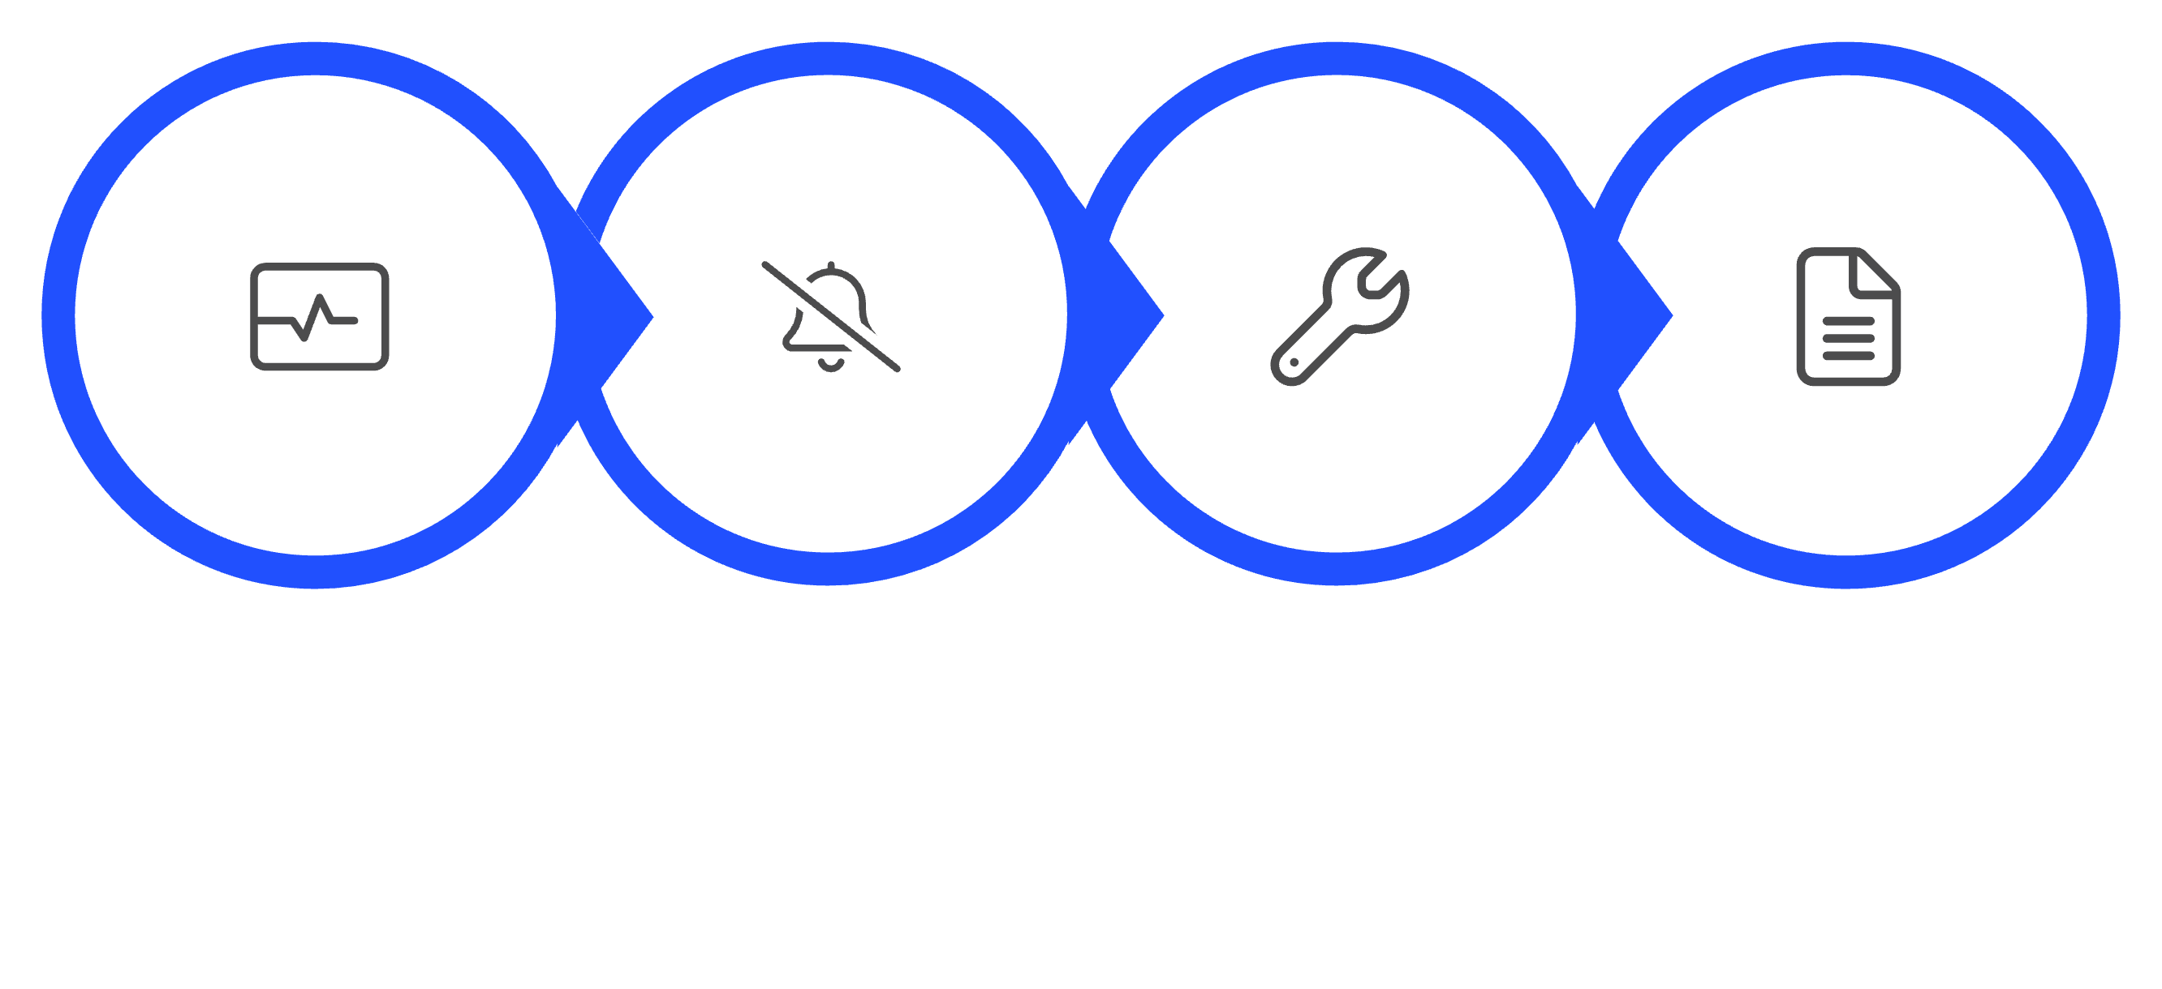
EXISTING SYSTEM
How Conventional OS Fault Management Works
Manual or Predefined Recovery
Process Monitoring
Fault Detection
Logging
Conventional operating systems rely on reactive mechanisms — faults are identified using process status, resource usage, and system logs, with administrators responding manually to alerts. Most approaches lack predictive capability.

Slide 4
PROBLEM
Drawbacks of Existing Systems
Reactive Handling
Delayed Detection
Faults detected only after they occur
Abnormal behavior not identified immediately
Manual Intervention
No Prediction
Admins must respond to every alert
Cannot anticipate faults in advance
Application Downtime
Inflexible Recovery
Poor Analysis
Unavailability during failure and recovery
Predefined mechanisms do not adapt to fault conditions
Recurring failures hard to analyze without centralized logging

Slide 5





SelfHealOS — Core Design
An AI-based framework that continuously observes system processes and uses collected metrics to identify abnormal behavior, predict faults, and trigger automated recovery.
Monitor
1
Collect process & system metrics
2
Detect
Identify abnormal behavior
3
Predict
AI/ML fault classification
4
Recover
Auto-select recovery action
5
Log
Record for analysis & improvement

Slide 6
ARCHITECTURE
System Architecture
1
Process Monitoring Module
2
Data Collection Module
3
Feature Extraction Module
4
Fault Detection & AI/ML Prediction
5
Fault Classification Module
6
Recovery Manager
7
Logging & Feedback Module

Slide 7








DATA FLOW
System Data Flow
Process Monitoring & Data Collection
OS Processes
Input from the operating system.
Continuous observation and gathering of system metrics.
1
2
Logging & Feedback Module
8
Feature Extraction
Recording of events and system learning for improvement.
3
Transformation of raw data into analytical features.
7
Recovery Action Execution
Fault Detection & AI/ML Prediction
4
Identification of anomalies and anticipation of failures.
Implementation of chosen recovery steps.
6
5
Recovery Manager
Fault Classification
Decision-making for appropriate recovery actions.
Categorization of detected faults.

Slide 8
REQUIREMENTS
Hardware & Software Requirements
Hardware
Software
Component
Specification
Component
Details
Processor
Intel Core i3 or equivalent
OS
Linux / Ubuntu
RAM
8 GB recommended
Language
Python
Storage
256 GB or above
Scripting
Bash
Network
Optional (implementation-dependent)
Libraries
psutil, NumPy, Pandas, Scikit-learn, Matplotlib
IDE
VS Code / PyCharm
Version Control
Git / GitHub

Slide 9
Expected Outcomes
Real-time process monitoring
Early identification of abnormal behavior
Automated fault detection & recovery
Reduced manual intervention
Detailed fault and recovery logs
Improved reliability & reduced downtime

